Slide 1

Zeno Berkhan, Nico Diefenbacher, (Paul Mayer)

Slide 2
Content
Introduction and idea
Requirements
Techstack
Project Management
Function Points
Usecases
Classdiagrams
Automation (Testing)
RISK Management
Testing
Demo

Slide 3



Introduction and Idea

Slide 5
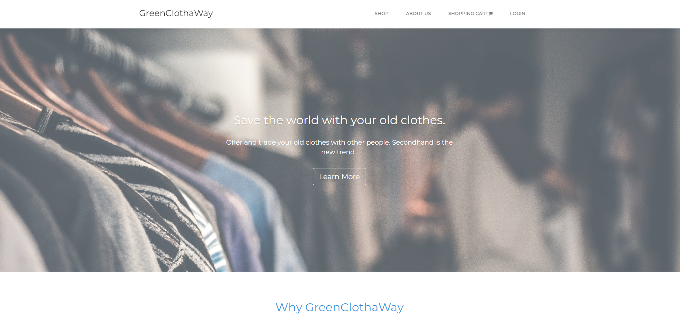

Slide 6
Requirements
Register to our site
Upload stuff
Contact people offering stuff
Browse all inserations
SAVE THE WORLD

Slide 7










Slide 8



Slide 9
Project Management
Weeklys/Homework
Stay on the right path

Slide 10
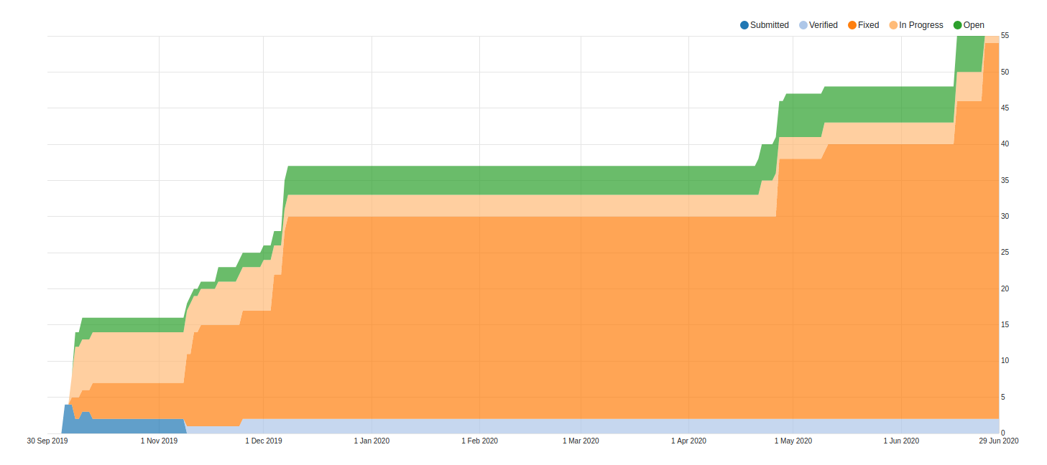
RUP Workflow (Cumulative Flow)

Slide 11
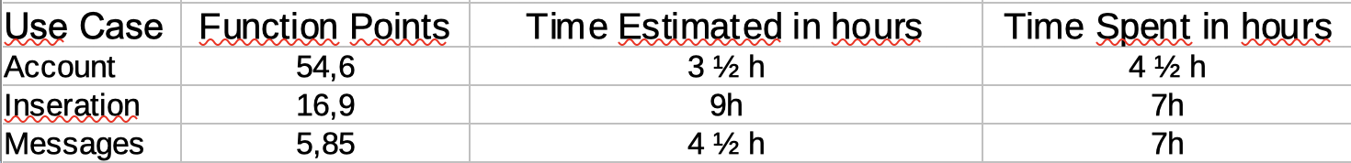

Slide 12
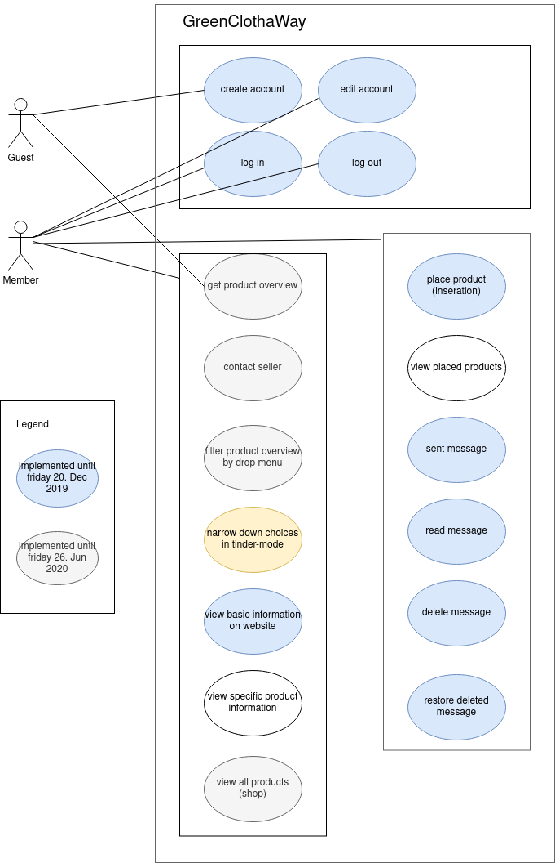
Usecases

Slide 13
Class Diagrams
Django

Slide 14
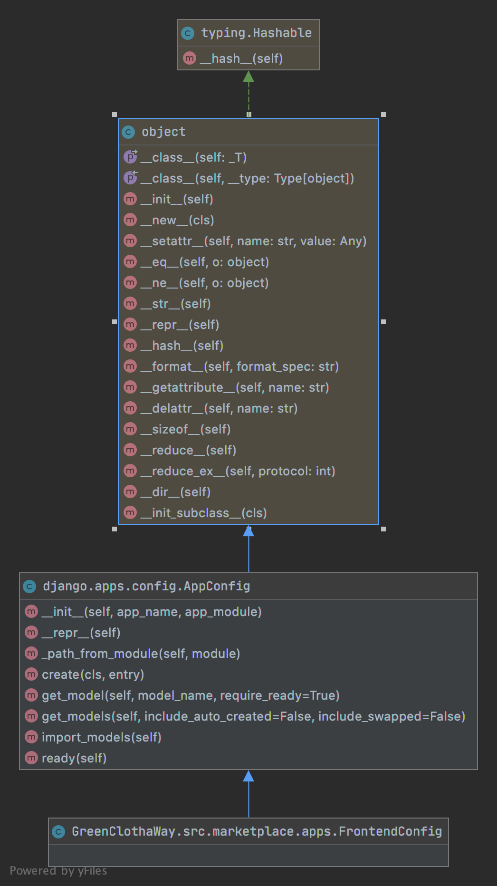
marketplace

Slide 15
Inseration

Slide 16
Account

Slide 17
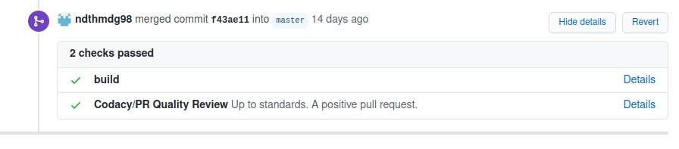
Automated testing (CI)
Account
on push/pull request to master

Slide 18
RISK Management
Account
I WILL SURVIVE!!!!

Slide 19
Testing
Account
Behavior driven test
Unittests
UX Tests

Slide 20
Demo

